Slide 1
REGIONAL SNAPSHOT
SET FOREVER Region, Louisiana

Slide 2
Table of contents
01
Overview
04
Labor force
02
Demography
05
Industry and occupation
03
Human capital

Slide 3
SET FOREVER Region, LA
What is a regional snapshot?
01
overview

Slide 4
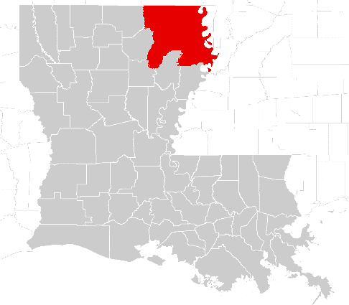
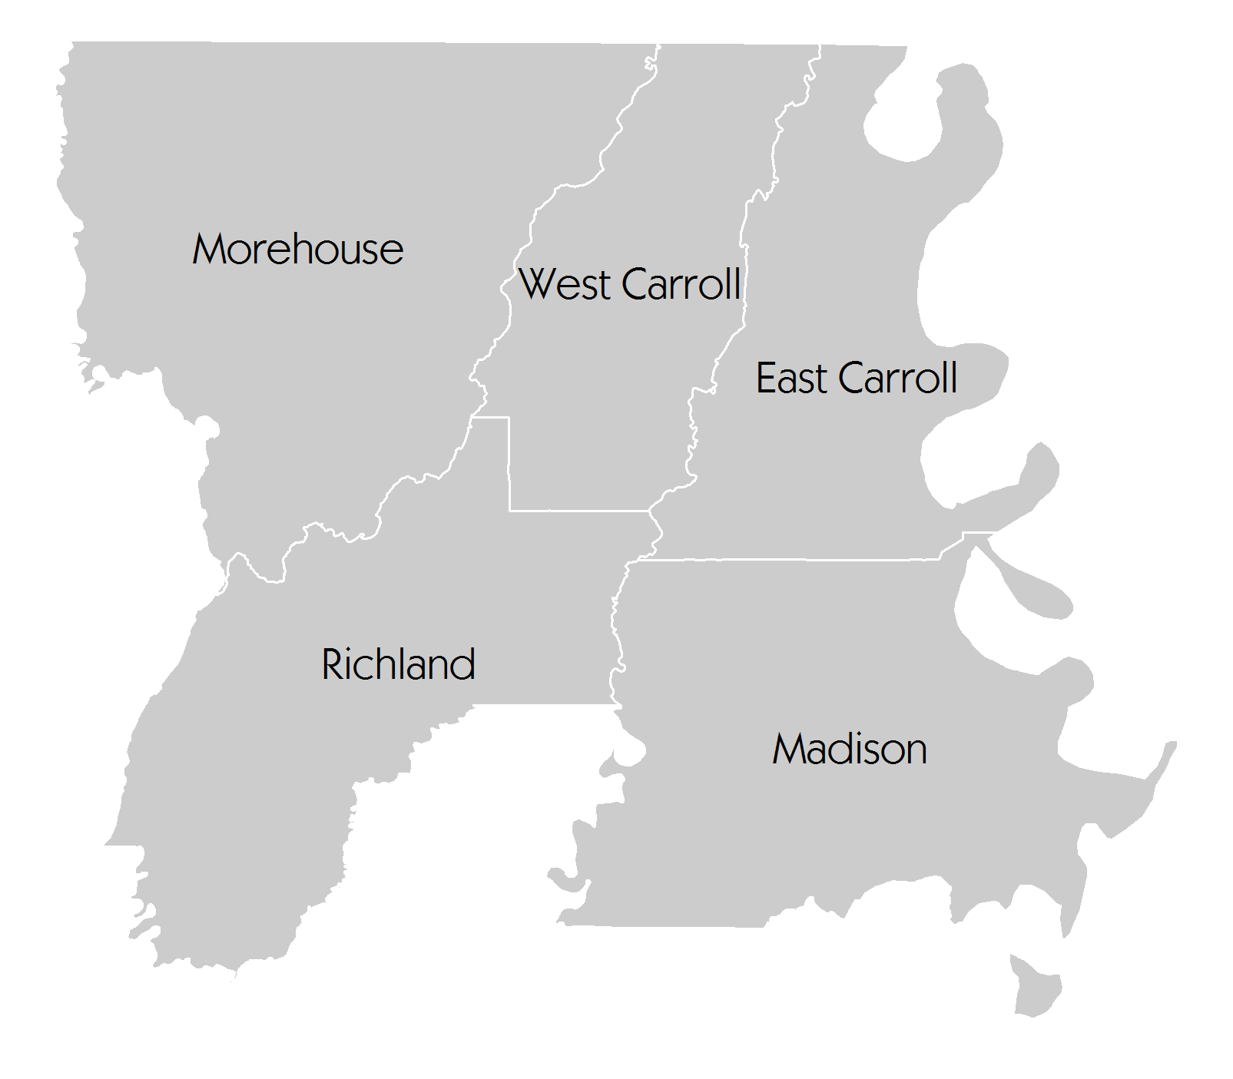
SET FOREVER Region
Overview
The SET FOREVER Region is comprised of five Louisiana counties. I-20 passes through the southern part of the region and connects to I-55 to the east.
East Carroll
Madison
Morehouse
Richland
West Carroll
section 01

Slide 5
What is a regional snapshot?
Overview
What is the snapshot?
This snapshot is a demographic and economic assessment of the SET FOREVER Region in Louisiana. Using county-level data, PCRD analyzed a number of indicators to gauge the overall economic performance of the SET FOREVER Region in comparison to the rest of the state.
What is its purpose?
The snapshot is intended to inform the region’s leaders, organizations and residents of the key attributes of the region’s population and economy. In particular, it takes stock of the region’s important assets and challenges. With such data in hand, regional leaders and organizations are in a better position to invest in the mix of strategies that will spur the growth of the economy and provide a higher quality of life for residents of the region.
What are its focus areas?
PCRD secured and analyzed recent data from both public and private sources to generate the snapshot. In order to build a more comprehensive picture of the region, the report presents information under four key categories.
Demography
Human Capital
Labor Force
Industry & Occupation
When appropriate or relevant, the report compares information on the region with data on the remainder of the state. By so doing, the region is better able to determine how well it is performing relative to the state on a variety of important metrics.
section 01

Slide 6
02
demography
Population change
Age structure
Income and poverty

Slide 7
Population change
Demography
Total population projections
1.6%
2.7%
-1.2%
SET FOREVER
4,453,212
4,571,321
4,516,550
4,381,511
-8.4%
-2.3%
Rest of Louisiana
87,465
80,160
-8.4%
78,355
71,760
2000
2000-2010
2010-2014
2014-2020
Questions:
How does the region’s population trend compare to that of the state?
What may be some of the elements driving the trends in the region? In the state?
What strengths or challenges might these trends present?
section 02
Source: 2000 & 2010 Census, 2014 Population Estimates, and 2020 Population Projection by Louisiana Government, http://louisiana.gov/Explore/Population_Projections/

Slide 8
Race
Demography
Ethnicity
2000
Hispanics - 2000
Hispanics - 2014
2014
2.0%
section 02
Race Data Source: U.S. Census Bureau – 2000 Decennial Census and 2014 Annual Population Estimates

Slide 9
Demography
Population Age Structure, 2000 A visual presentation of the age distribution of the population (in percent)
section 02
Source: 2000 Decennial Census, U.S. Census Bureau

Slide 10
Demography
Population Age Structure, 2014 A visual presentation of the age distribution of the population (in percent)
Questions:
Is the region experiencing an aging of its population? How does this compare to the rest of the state?
Is there a sizable number of people of prime working age (20-49 years of age) in the region?
Is the youth population (under 20 years old) growing or declining?
What are the implications of the region’s age structure for the economic development efforts of the region?
section 02
Source: 2014 Population Estimates, U.S. Census Bureau

Slide 11
Demography
Income and poverty
Questions:
Is the poverty rate for individuals in the county getting better or worse?
Is poverty for minors in the county lower or higher than the overall poverty rate for all individuals? Why?
Has real median income (adjusted for inflation) improved or worsened over the 2003 to 2013 time period? What may be reasons for these changes?
 | 2003 | 2008 | 2013
Total Population in Poverty | 24.6% | 27.8% | 30.3%
Minors (Age 0-17) in Poverty | 37.6% | 40.2% | 43.7%
Real Median Household Income* ($ 2013) | $31,485 | $32,434 | $30,245
section 02
* Note: Regional Median Household income is the population-weighted average of median household income values across the SET FOREVER counties.
Source: U.S. Census Bureau – Small Area Income and Poverty Estimates (SAIPE)

Slide 12
03
human capital
Educational attainment
Patents

Slide 13
Educational attainment, 2013
Human capital
SET FOREVER
Region
Rest of Louisiana
Questions:
What proportion of the adult population in the region has only a high school education?
How many are college graduates (bachelors degree or higher)?
How does the educational profile of the region compare to that of the rest of the state?
What are the implications of the educational profile of the region in terms of the region’s economic opportunities or workforce challenges?
No high school
Associate’s degree
Some high school
Bachelor’s degree
High school diploma
Graduate degree
Some college
section 03
Source: 2009-2013 American Community Survey 5-Year Estimates

Slide 14
Patents
Human capital
Patents per 10,000 Jobs
2000-2013
From 2000 to 2013, SET FOREVER counties were issued patents at a rate of 0.77 per 10,0000 jobs, while the remaining Louisiana counties garnered 1.45 patents per 10,000 jobs.
Patenting trends are an important indicator of the level of innovation in a region.
Commercializing this innovation can lead to long-term growth for regional economies.
Questions:
How does the region’s patent rate compare to that of the rest of the state?
How have rates changed over time?
What might this data suggest for the future of the region?
Patents per 10,000 residents
2000-2013
From 2000 to 2013, 0.31 patents per 10,000 residents were issued in SET FOREVER counties. The rest of Louisiana amassed 1.47 patents per 10,000 residents.
section 03
Source: U.S. Patent and Trademark Office, Census, BEA, and EMSI
*Note: Patent origin is determined by the residence of the first-named inventor. Since a number of workers commute into the region, the number of patents produced in the FOREVER Region could be high. However, among residents of the region, patent production is relatively low.

Slide 15
04
labor force
Unemployment rates
Earnings per worker
Source of labor for the region

Slide 16
Unemployment rates
Labor force
Questions:
How does the region’s unemployment rate compare to the rest of the state and nation?
How does the region’s unemployment peak and post-2009 recovery compare to the state and nation?
What might this suggest for the region’s economic future?
SET FOREVER Region
US Total
Rest of State
section 04
Source: LAUS, BLS

Slide 17
Earnings per worker in 2014
Labor force
Questions:
How does the region’s average earnings compare to that of the rest of the state?
What might be some driving factors for the differences?
Do these represent potential strengths or challenges for the region?
NOTE: Earnings include wages, salaries, supplements and earnings from partnerships and proprietorships.
SET FOREVER
Rest of
Louisiana
Average earnings
section 04
Source: EMSI Class of Worker 2014.4 (QCEW, non-QCEW, self-employed and extended proprietors)

Slide 18
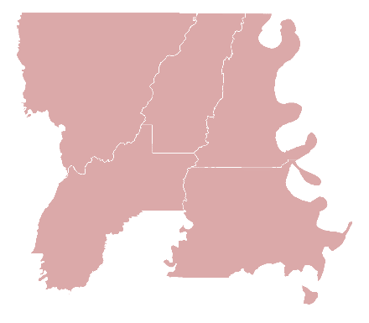
Labor force
Journey to Work
In-Commuters
Same Work/Home
Out-Commuters
6,772
13,686
19,293
Population | 2013 Jobs | Proportion
Employed in Region | 20,458 | 100.0%
Employed in Region but Living Outside | 6,772 | 33.1%
Employed and Living in Region | 13,686 | 66.9%
Population | 2013 Jobs | Proportion
Region Residents | 32,979 | 100.0%
Employed Outside Region but Living in Region | 19,293 | 58.5%
Employed and Living in Region | 13,686 | 41.5%
Questions:
How many people employed in the region actually reside outside the region? How many who live in the region commute to jobs outside the region?
What are the implications for the region’s economic development efforts?
section 04
Source: LEHD, OTM, U.S. Census Bureau

Slide 19
05
industry
and occupation
Establishments
Employment by industry
Cluster analysis
Top occupations
STEM occupations

Slide 20
Establishments
Industry and occupation
Components of Change for Establishments 2000-2011
Establishments Launched | 9,600
Establishments Closed | 4,616
Net Change | 4,984
Net Migration (number leaving vs. the number moving into the region) | -13
Total Change | 4,971
Percent Change | 127.2%
An establishment is a physical business location.
Branches, standalones
and headquarters are all considered types of establishments.
Definition of Company Stages
0 1
Self-employed
2-9 employees
3
10-99
employees
100-499
employees
4
500+
employees
section 05
Source: National Establishment Time Series (NETS) – 2011 Database

Slide 21
Establishments
Industry and occupation
Number of Establishments by Company Stages
 | 2000 |  | 2011
Stage | Establishments | Proportion | Establishments | Proportion
Stage 0 | 937 | 24% | 3,950 | 44.5%
Stage 1 | 2,391 | 61.2% | 4,359 | 49.1%
Stage 2 | 555 | 14.2% | 540 | 6.1%
Stage 3 | 25 | 0.6% | 30 | 0.3%
Stage 4 | 1 | 0.0% | 1 | 0.0%
Total | 3,909 | 100% | 8,880 | 100%
Questions:
What stage businesses have shaped the region’s economic growth in the last 10 years?
Which ones are growing or declining the most?
Which stage of establishments are likely to shape the region’s future economic growth?
section 05
Source: National Establishment Time Series (NETS) – 2011 Database

Slide 22
Establishments
Industry and occupation
Questions:
What establishments are the most numerous based on company stages?
What stages have experienced the largest growth? The greatest decline?
What company stage employs the largest number of people?
What stage captures the most sales?
Which ones have experienced the greatest percentage loss over the 2000-11 period?
Number of Jobs by Company Stages
Year | 2000 | 2011 | % Change
Stage 0 | 937 | 3,950 | 321.6%
Stage 1 | 8,485 | 12,718 | 49.9%
Stage 2 | 14,207 | 13,753 | -3.2%
Stage 3 | 3,866 | 4,605 | 19.1%
Stage 4 | 1,112 | 900 | -19.1%
Total | 28,607 | 35,926 | 25.6%
Sales ($ 2013) by Company Stages
Year | 2000 | 2011 | % Change
Stage 0 | $108,948,137 | $258,284,996 | 137.1%
Stage 1 | $1,109,189,125 | $1,077,098,235 | -2.9%
Stage 2 | $1,722,416,602 | $1,404,374,094 | -18.5%
Stage 3 | $443,519,156 | $422,211,205 | -4.8%
Stage 4 | $102,912,340 | $59,314,198 | -42.4%
Total | $3,486,985,359 | $3,221,282,728 | -7.6%
section 05
Source: National Establishment Time Series (NETS) – 2011 Database

Slide 23
Top ten industry sector employment growth
Industry and occupation
NAICS | Description | 2009 Jobs | 2014 Jobs | Change | Change (%) | State Change (%)
61 | Educational Services | 332 | 540 | 208 | 63% | 23%
31 | Manufacturing | 1,123 | 1,720 | 597 | 53% | 4%
56 | Administrative and Support and Waste Management and Remediation Services | 989 | 1,420 | 431 | 44% | 16%
53 | Real Estate and Rental and Leasing | 849 | 1,147 | 298 | 35% | 20%
42 | Wholesale Trade | 879 | 1,057 | 178 | 20% | 5%
21 | Mining, Quarrying, and Oil and Gas Extraction | 111 | 132 | 21 | 19% | 9%
55 | Management of Companies and Enterprises | 265 | 303 | 38 | 14% | 7%
62 | Health Care and Social Assistance | 5,566 | 6,251 | 685 | 12% | 12%
72 | Accommodation and Food Services | 1,456 | 1,635 | 179 | 12% | 18%
52 | Finance and Insurance | 1,093 | 1,227 | 134 | 12% | 11%
Questions:
What regional industry sectors have seen the greatest growth?
Did they grow at the same rate as the state?
What factors are causing the growth?
section 05
Source: EMSI Class of Worker 2014.4 (QCEW, non-QCEW, self-employed and extended proprietors)

Slide 24
Top four industry sector employment decline
Industry and occupation
NAICS | Description | 2009 Jobs | 2014 Jobs | Change | Change (%) | State Change (%)
51 | Information | 169 | 136 | -33 | -20% | 3%
90 | Government | 5,988 | 5,271 | -717 | -12% | -9%
23 | Construction | 1,424 | 1,336 | -88 | -6% | 1%
54 | Professional, Scientific, and Technical Services | 712 | 692 | -20 | -3% | 6%
Questions:
How does the industry sector make-up of the region compare to the rest of the state?
Which industry sectors are growing and declining the most in employment?
section 05
Source: EMSI Class of Worker 2014.4 (QCEW, non-QCEW, self-employed and extended proprietors)

Slide 25
Industry cluster analysis
How to interpret cluster data results The graph’s four quadrants tell a different story for each cluster.
Contains clusters that are more
concentrated in the region but
are declining (negative growth).
These clusters typically fall
into the lower quadrant as
job losses cause a decline
in concentration.
Contains clusters that are more
concentrated in the region and are
growing. These clusters are
strengths that help a region
stand out from the competition.
Small, high-growth clusters
can be expected to become
more dominant over time.
Stars
Top right (strong and advancing)
Mature
Top left (strong but declining)
Emerging
Bottom right
(weak but advancing)
Transforming
Bottom left
(weak and
declining)
Contains clusters that are
under-represented in the
region (low concentration)
and are also losing jobs.
Clusters in this region may
indicate a gap in the workforce
pipeline if local industries anticipate
a future need. In general, clusters in this
quadrant show a lack of competitiveness.
Contains clusters that are
under-represented in the
region but are growing, often
quickly. If growth trends
continue, these clusters will
eventually move into the top right
quadrant. Clusters in this quadrant
are considered emerging strengths
for the region.
section 05
Modified from: http://www.charlestonregionaldata.com/bubble-chart-explanation/

Slide 26
Distribution of clusters in the Region by quadrants
Industry and occupation
section 05

Slide 27
Industry cluster analysis
Mature Clusters
No clusters in this category
Star Clusters
Primary Metal Mfg. (5.13, 376)
Agribusiness, Food Processing & Technology (5.00, 4,758)
Biomedical/Biotechnical (Life Sciences) (1.64, 4,121)
Level of Specialization
Percent Growth in Specialization
Transforming Clusters
Forest & Wood Products (0.81, 371)
Fabricated Metal Product Mfg. (0.63, 164)
Manufacturing Supercluster (0.54, 585)
Education & Knowledge Creation (0.23, 168)
Printing & Publishing (0.18, 100)
Information Technology & Telecommunications (0.18, 229)
Emerging Clusters
Energy (Fossil & Renewable) (0.89, 1,541)
Mining (0.69, 66)
Transportation & Logistics (0.68, 685)
Advanced Materials (0.60, 575)
Business & Financial Services (0.47, 2,025)
Defense & Security (0.43, 593)
Arts, Entertainment, Recreation & Visitor Industries (0.33, 433)
Chemicals (0.31, 122)
Note: Apparel & Textiles and Glass & Ceramics clusters and Transportation Equipment Mfg., Electrical Equip, Appliance & Component Mfg. and Machinery Mfg. subclusters have too few jobs. Computer & Electronic Product Mfg. does not exist in the region.
section 05
NOTE: The first number after each cluster represents its location quotient while the second number represents the number of total jobs (full and part time jobs by place of work) in that cluster in the region in 2014. The clusters are sorted in decreasing order by location quotient.

Slide 28
Regional requirements, 2014
Industry Clusters: Leakages
Note: ** shows Star clusters
section 05
Source: EMSI 2014.4 (QCEW Employees, Non-QCEW Employees, Self-Employed, and Extended Proprietors); Industry cluster definitions by PCRD

Slide 29
Top five occupations in 2014
Industry and occupation
Questions:
What are the education and skill requirements for these occupations?
Do the emerging and star clusters align with the top occupations?
What type salaries do these occupations typically provide?
section 05
Source: EMSI Class of Worker 2014.4 (QCEW, non-QCEW, self-employed and extended proprietors)

Slide 30
Science, Technology, Engineering & Math
Industry and occupation
Job change in STEM occupations
63,451
63,191
SET-Forever Region
339
323
-4.7%
-0.41%
Rest of Louisiana
2009
2014
Change
Source: EMSI Class of Worker 2014.4 (QCEW, non-QCEW, self-employed and extended proprietors)
Questions:
How do STEM jobs compare to the state?
What has been the trend of STEM jobs over time?
How important are STEM jobs to the region’s Star and Emerging clusters?
*Note: STEM and STEM-related occupation definitions from BLS (2010)
section 05
Source: EMSI Class of Worker 2014.4 (QCEW, non-QCEW, self-employed and extended proprietors)

Slide 31
Report Contributors This report was prepared by the Purdue Center for Regional Development, in partnership with the Southern Rural Development Center and USDA Rural Development, in support of the Stronger Economies Together program.
Report Authors
Bo Beaulieu, PhD
Indraneel Kumar, PhD
Andrey Zhalnin, PhD
Data Analysis
Ayoung Kim
Francisco Scott
Yong Kim
Report Design
Tyler Wright
This report was supported, in part, by grant from the USDA Rural Development through the auspices of the Southern Rural Development Center. It was produced in support of the Stronger Economies Together (SET) program.

Slide 32
For more information,
please contact:
Dr. Bo Beaulieu,
PCRD Director:
ljb@purdue.edu
Or
765-494-7273
The Purdue Center for Regional Development (PCRD) seeks to pioneer new ideas and strategies that contribute to regional collaboration, innovation and prosperity.
October 2015

